Slide 1
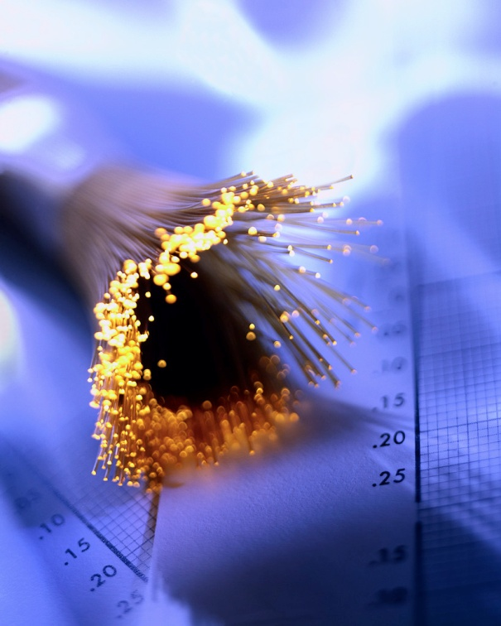
The Optical Fiber and Light Wave Propagation
Xavier Fernando
Ryerson Comm. Lab

Slide 2
The Optical Fiber
Fiber optic cable functions as a ”light guide,” guiding the light from one end to the other end.
Fiber categories based on propagation:
Single Mode Fiber (SMF)
Multimode Fiber (MMF)
Categories based on refractive index profile
Step Index Fiber (SIF)
Graded Index Fiber (GIF)

Slide 3
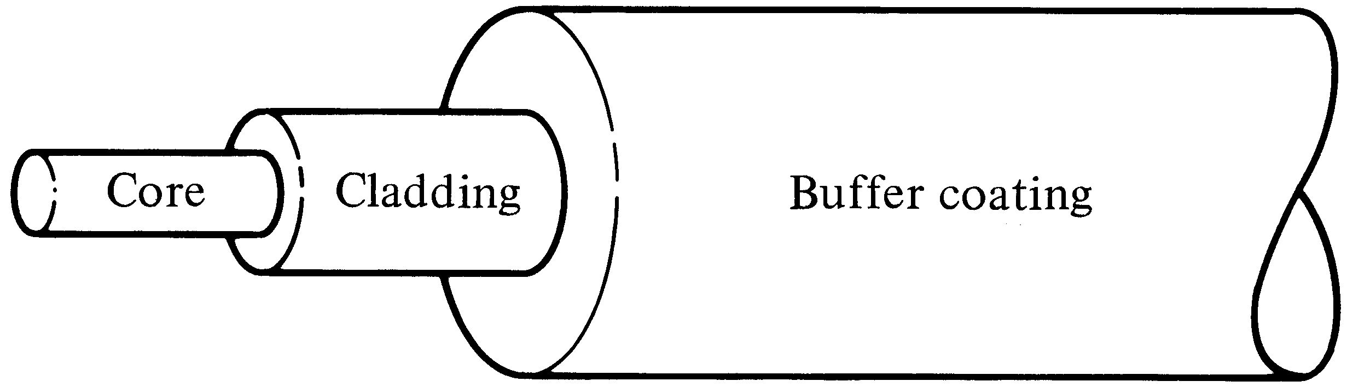
Step Index Fiber
n₁
n₂
n₁>n₂
Uniform ref. index of n₁ (1.44 < n₁ < 1.46) within the core and a lower ref. index n₂ in the cladding.
The core and cladding radii are a and b. Typically 2a/2b are 8/125, 50/125, 62.5/125, 85/125, or 100/140 µm.
SIF is generally made by doping high-purity fused silica glass (SiO₂) with different concentrations of materials like titanium, germanium, or boron.

Slide 4
Different Light Wave Theories
Different theories explain light behaviour
We will first use ray theory to understand light propagation in multimode fibres
Then use electromagnetic wave theory to understand propagation in single mode fibres
Quantum theory is useful to learn photo detection and emission phenomena

Slide 5
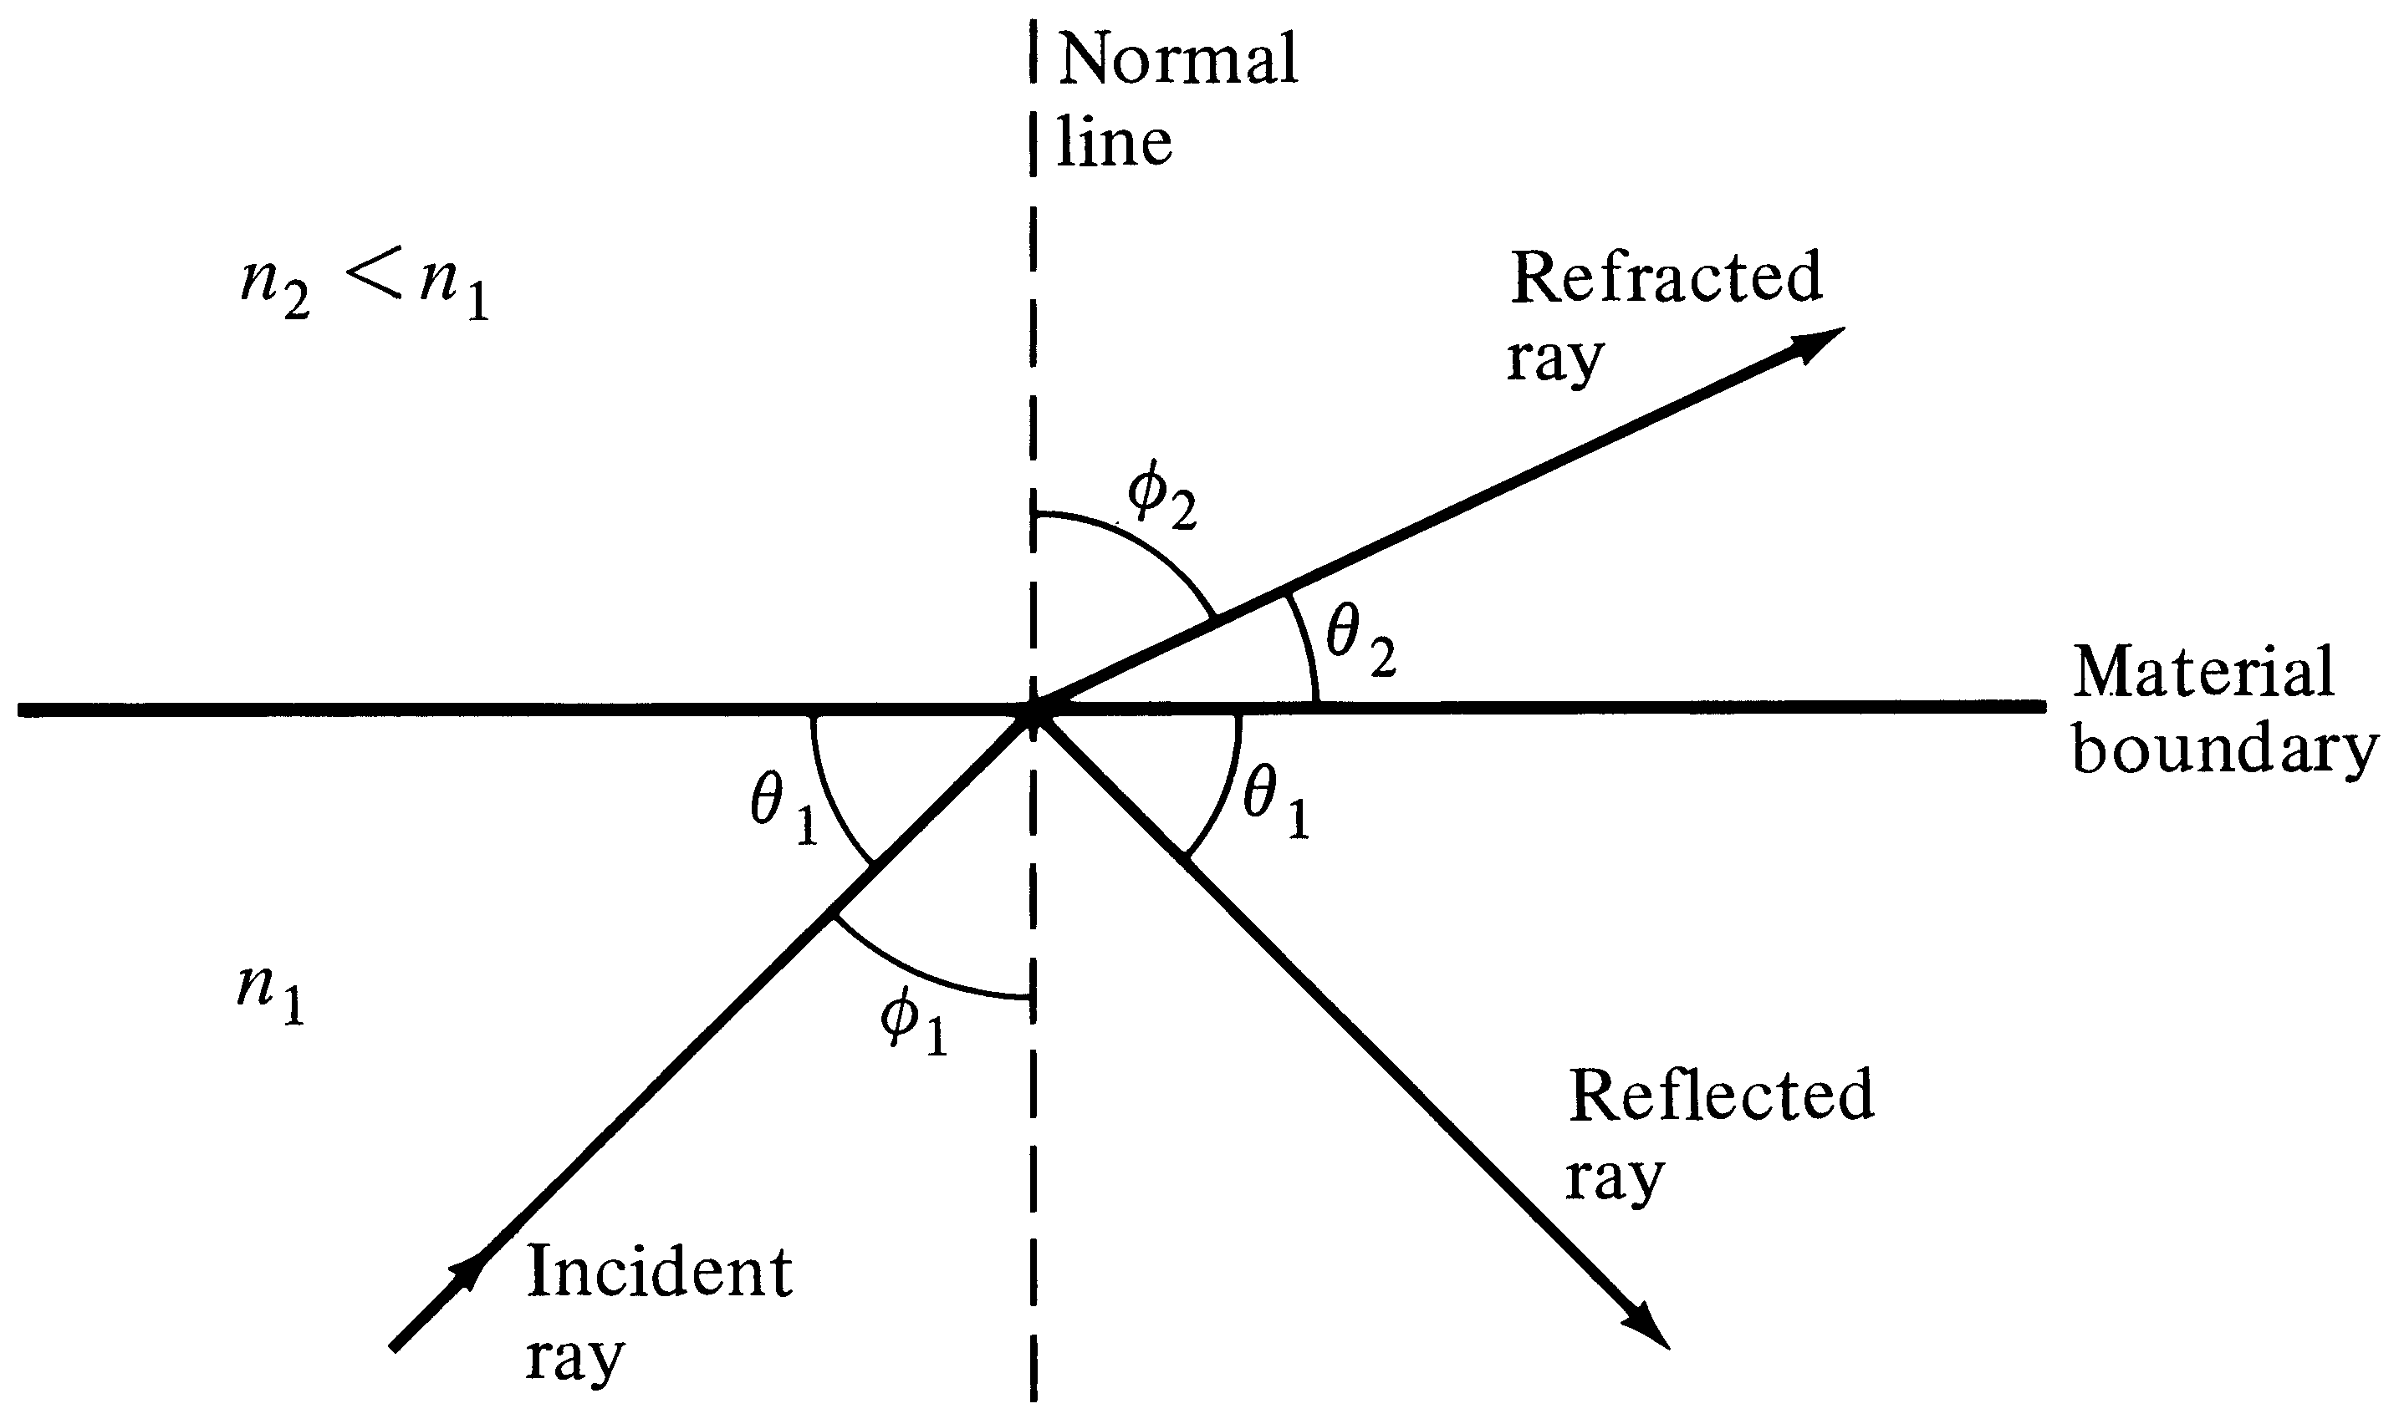
Refraction and Reflection
When Φ₂ = 90, Φ₁ = Φc is the Critical Angle
Φc=Sin⁻¹(n₂/n₁ )
Snell’s Law: n₁ Sin Φ₁ = n₂ Sin Φ₂
Notes:
6

Slide 6
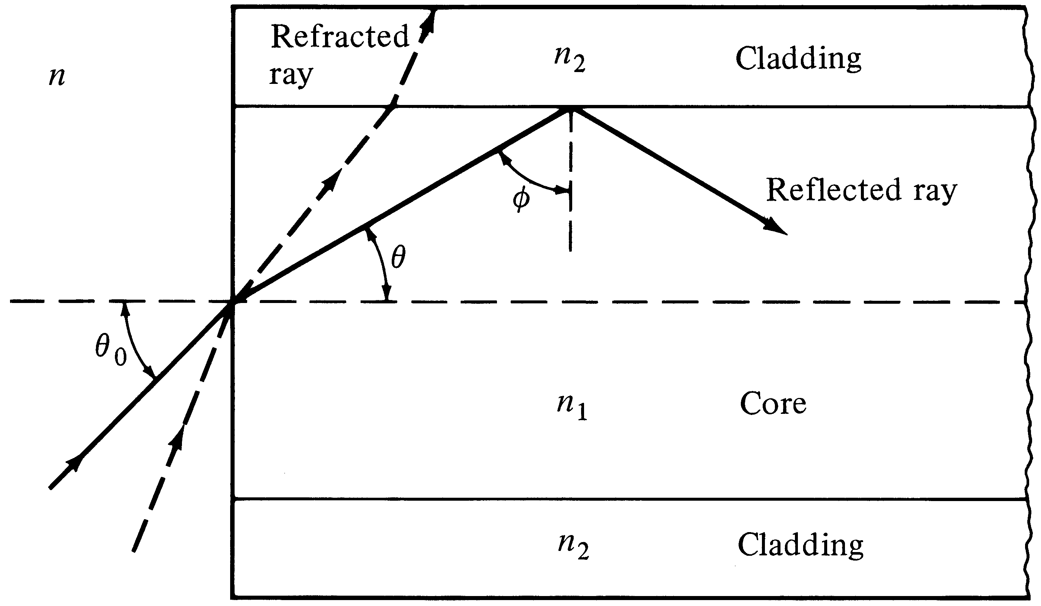
Step Index Multimode Fiber
Fractional refractive-index profile

Slide 7
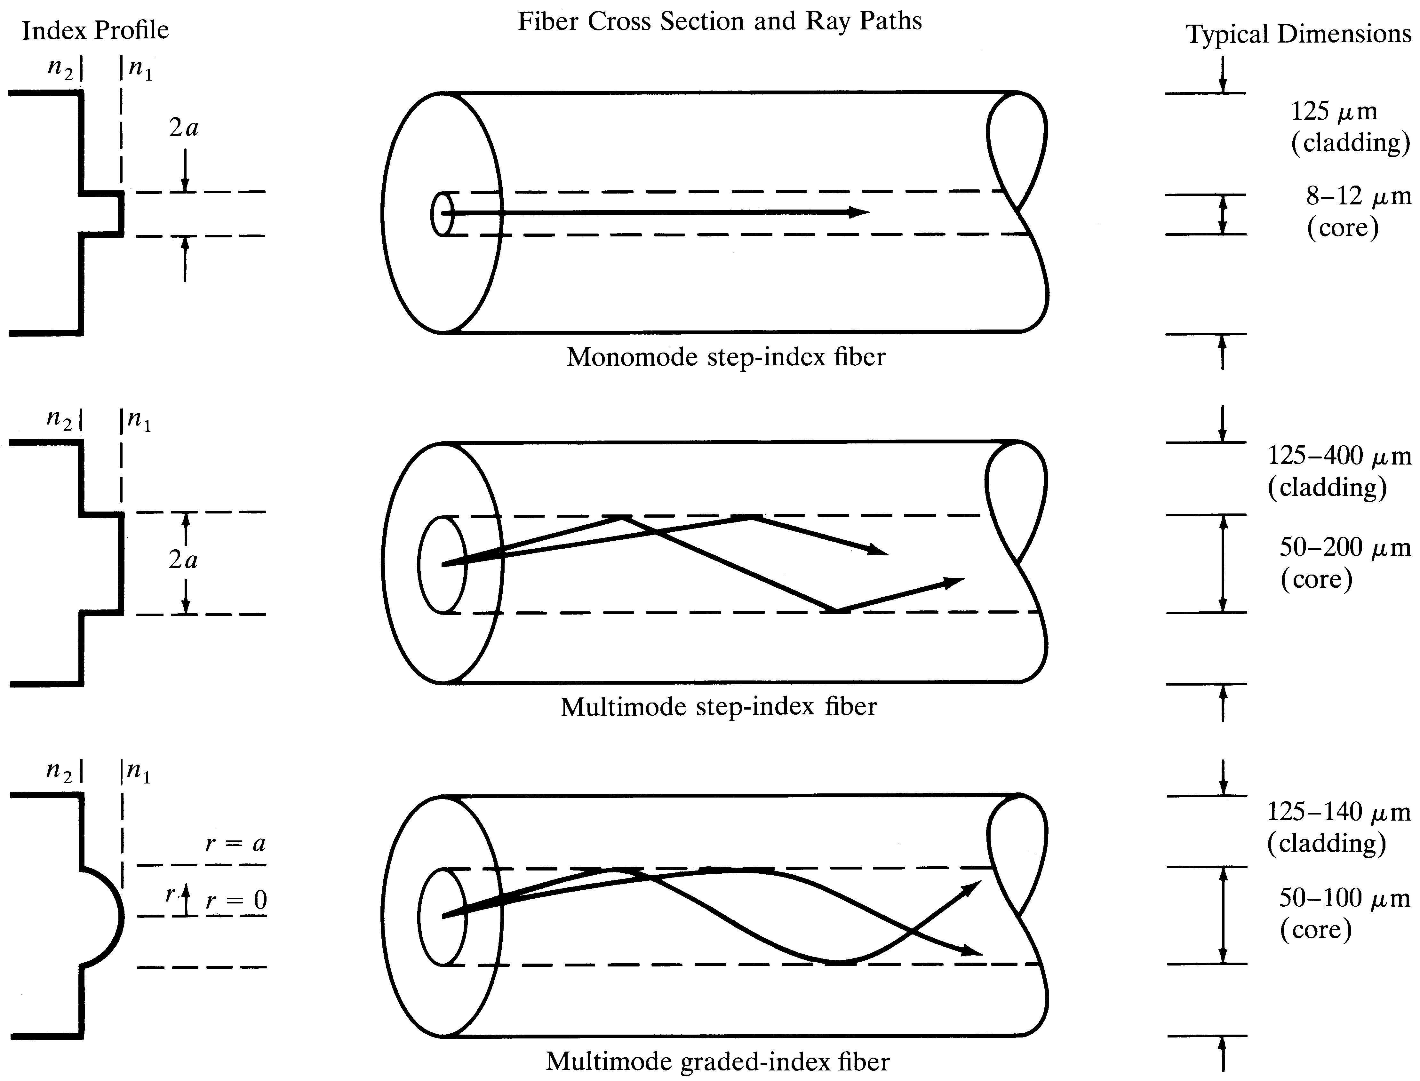
Ray description of different fibers

Slide 8
Single Mode Step Index Fiber
Only one propagation mode is allowed in a given wavelength.
This is achieved by very small core diameter (8-10 µm)
SMF offers highest bit rate, most widely used in telecom

Slide 9
Step Index Multimode Fiber
Guided light propagation can be explained by ray optics
When the incident angle is smaller than the acceptance angle, the light will propagate via TIR
a Large number of modes possible
Each mode travels at a different velocity
Modal Dispersion
Used in short links, mostly with LED sources

Slide 10
Graded Index Multimode Fiber
Core refractive index gradually changes towards the cladding
The light ray gradually bends and the TIR happens at different points
The rays that travel longer distance also travel faster
Offer less modal dispersion compared to Step Index MMF

Slide 11
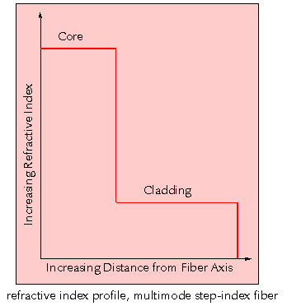
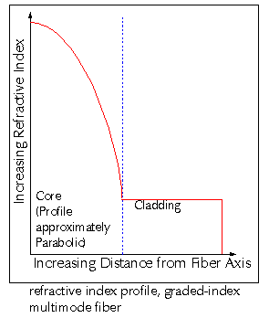

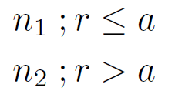
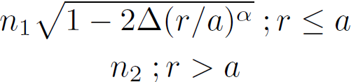
Refractive Index Profile of Step and Graded Index Fibers
n₁
n₁
Step
Graded
n₂
n₂
a
b
a
b
n =
n =

Slide 12
Step and Graded Index Fibers

Slide 13
Total Internal Reflection in Graded Index Fiber

Slide 14
Total Internal Reflection in Graded Index Fiber - II

Slide 15
Skew Rays

Slide 16





Maxwell’s Equations
In a linear isotropic dielectric material with no currents and free of charges,
……..(1) (Faraday’s Law)
E: Electric Field
……….(2) (Maxwell’s Faraday equation)
H: Magnetic Field
……….(3) (Gauss Law)
……….(4) (Gauss Law for magnetism)
Taking the curl of (1) and using and
…….(5)
The parameter ε is permittivity and μ is permeability.

Slide 17



Maxwell’s Equations
But from the vector identity
……(6)
Using (5) and (3), …….(7)
Similarly taking the curl of (2), it can be shown
………(8)
(7) and (8) are standard wave equations. Note the Laplacian operation is,

Slide 18





Maxwell’s Equation
Electrical and magnetic vectors in cylindrical coordinates are given by,
.…..(9)
……(10)
Substituting (9) and (10) in Maxwell’s curl equations
….(11)
….(12)
….(13)

Slide 19



Maxwell’s Equation
Also
----------(14)
----------(15)
----------(16)
By eliminating variables, above can be rewritten such that when E_{z} and H_{z} are known, the remaining transverse components E_{r ,} E_{φ,} H_{r ,} H_{φ,} can be determined from (17) to (20).

Slide 20






Maxwell’s Equation
…………..(17)
…………..(18)
…..........(19)
.………… (20)
Substituting (19) and (20) into (16) results in
….…(21)
…….(22)

Slide 21
Electric and Magnetic Modes
Note (21) and (22) each contain either E_{z} or H_{z} only. This may imply E_{z} and H_{z} are uncoupled. However. Coupling between E_{z} and H_{z} is required by the boundary conditions.
If boundary conditions do not lead to coupling between field components, mode solution will imply either E_{z} =0 or H_{z} =0. This is what happens in metallic waveguides.
When E_{z} =0, modes are called transverse electric or TE modes
When H_{z} =0, modes are called transverse magnetic or TM modes
However, in optical fiber hybrid modes also will exist (both E_{z} and H_{z} are nonzero). These modes are designated as HE or EH modes, depending on either H or E component is larger.

Slide 22




Wave Equations for Step Index Fibers
Using separation of variables
………..(23)
The time and z-dependent factors are given by
………..(24)
Circular symmetry requires, each field component must not change when Ø is increased by 2п. Thus
…………(25)
Where υ is an integer.
Therefore, (21) becomes
….(26)

Slide 23
Wave Equations for Step Index Fibers
Solving (26). For the fiber core region, the solution must remain finite as r→0, whereas in cladding, the solution must decay to zero as r→∞
Hence, the solutions are
In the core, (r < a),
Where, J_{v} is the Bessel function of first kind of order v
In the cladding, (r > a),
Where, K_{v} is the modified Bessel functions of second kind

Slide 24
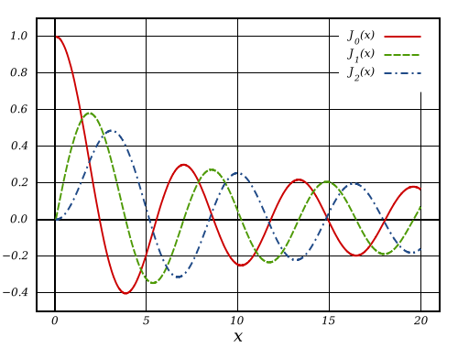
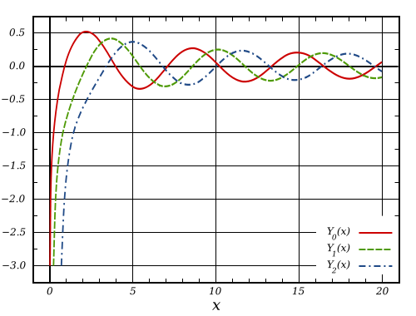
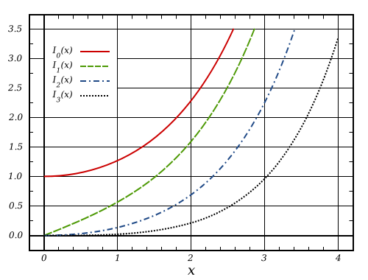
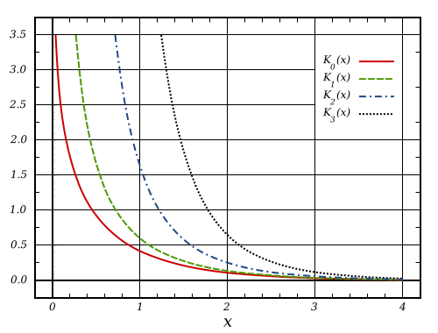
Bessel Functions First Kind
Bessel Functions Second kind
Modified Bessel first kind
Modified Bessel Second kind

Slide 25




Propagation Constant β
From the definition of modified Bessel function
Since Kv(wr) must go to zero as r→∞, w>0. This implies that
A second condition can be deduced from the behavior of Jv(ur). Inside core u is real for F₁ to be real, thus,
Hence, the permissible range of β for bound solutions is

Slide 26
Meaning of u and w
Inside the core, we can write,
Outside the core, we can write,
Both u and w describes guided wave variation in radial direction
u is known as guided wave radial direction phase constant (J_{n} resembles sine function)
w is known as guided wave radial direction decay constant (recall K_{n} resemble exponential function)

Slide 27
V-Number (Normalized Frequency)
Define the V-Number (Normalized Frequency) as,
Define the normalized propagation const b as,
All but HE₁₁ mode will cut off when b = 0.
Hence, for single mode condition,

Slide 30
Field Distribution in the SMF

Slide 31
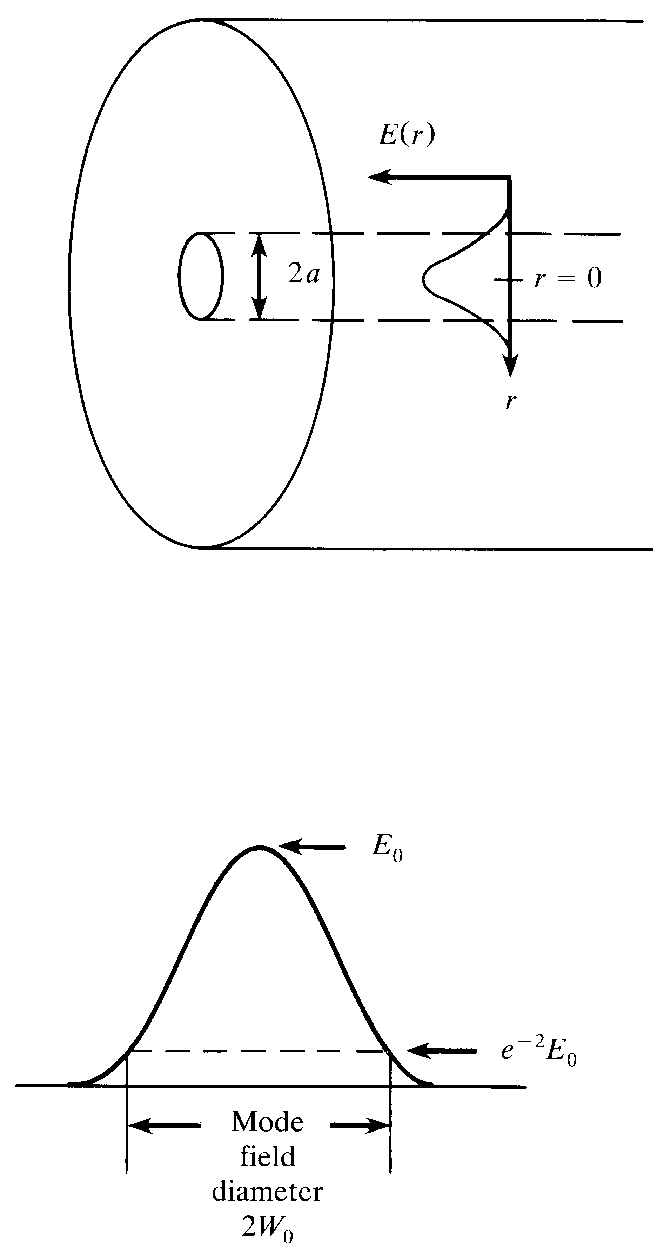
Mode-field Diameter (2W₀)
In a Single Mode Fiber,
At r = w_{o,}
E(W_{o})=E_{o}/e
Typically W_{o} > a

Slide 32
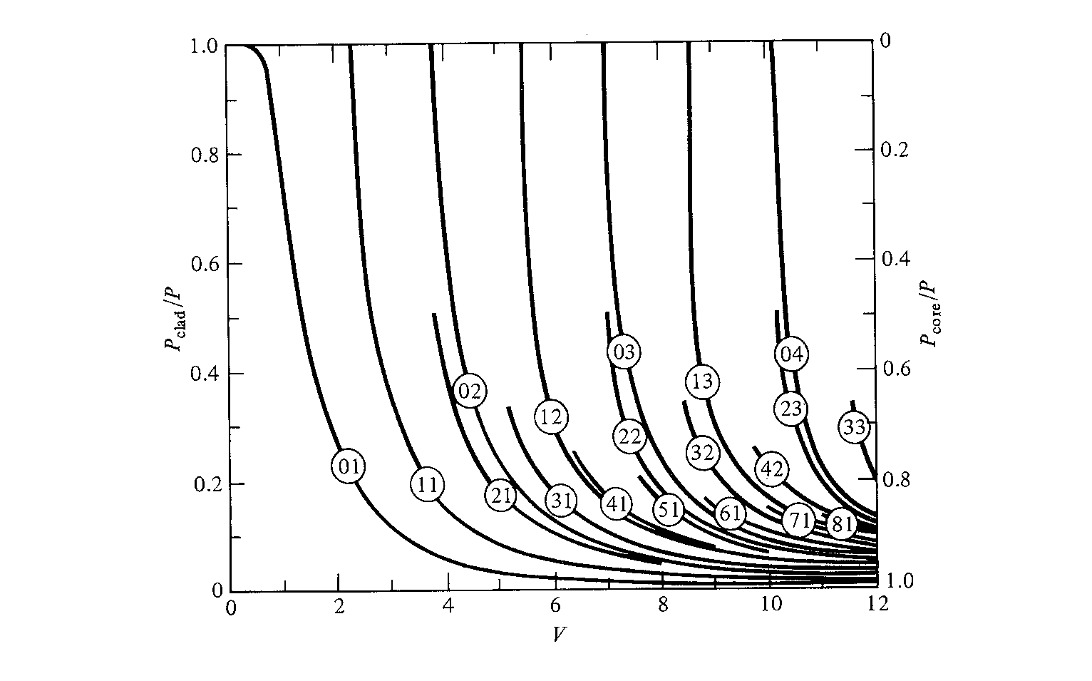
Cladding Power Vs Normalized Frequency
Modes
V_{c} = 2.4

Slide 33
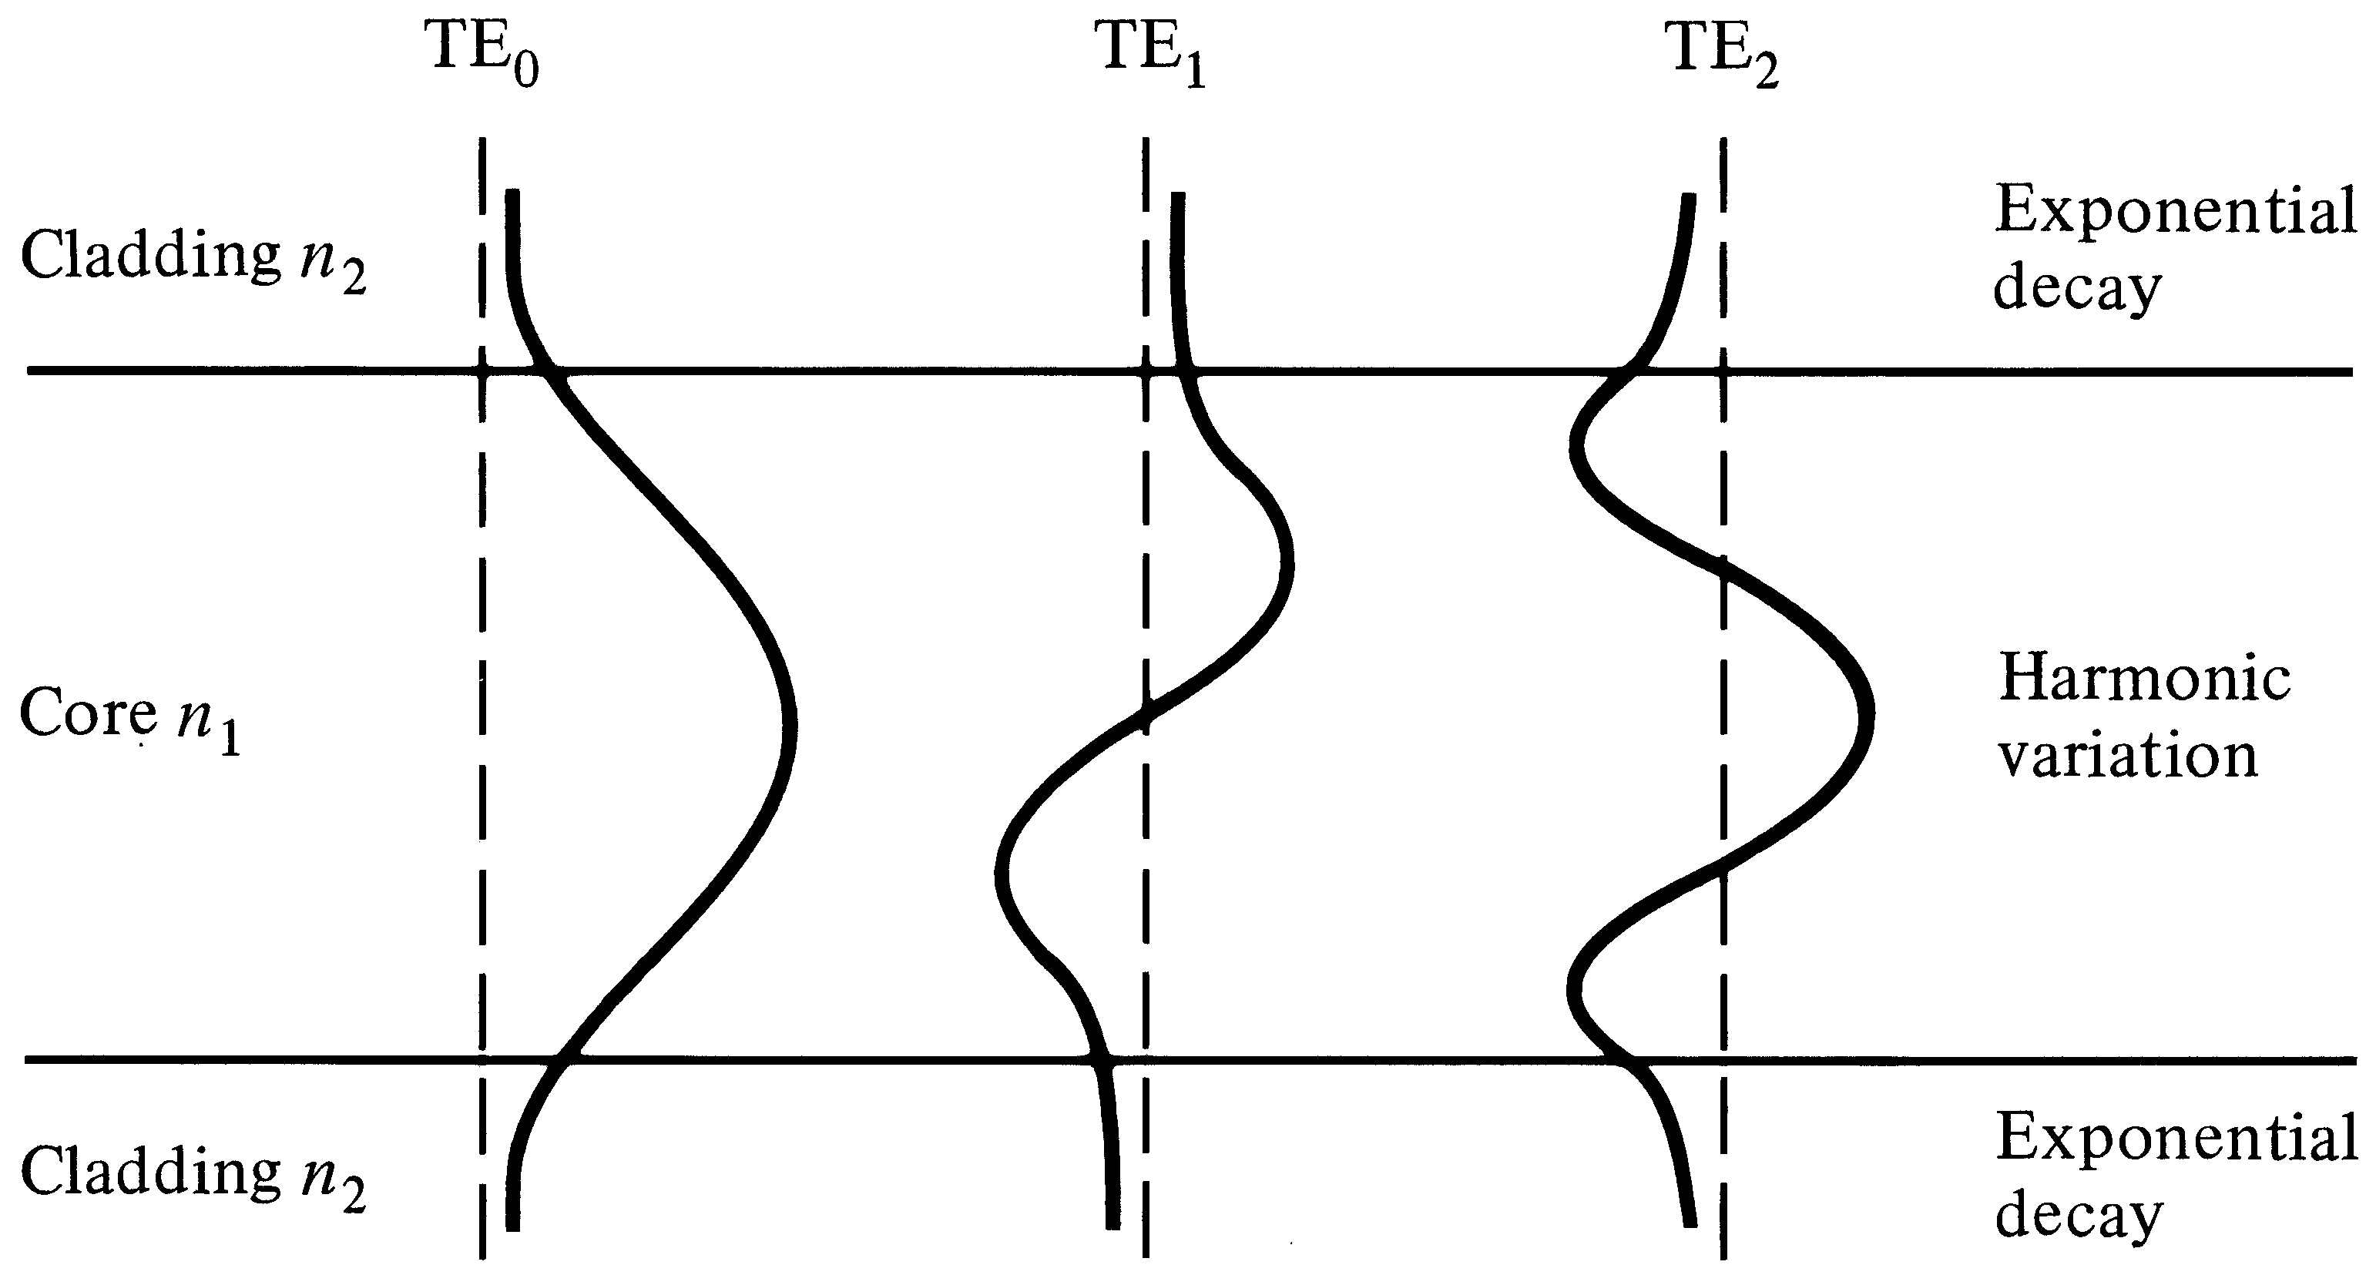
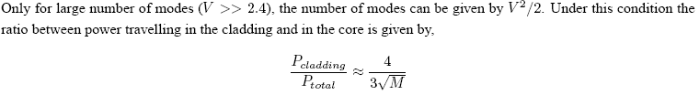
Power in the cladding
Lower order modes have higher power in the cladding → larger MFD

Slide 34
Higher the Wavelength → More the Evanescent Field

Slide 35
Light Intensity

Slide 36
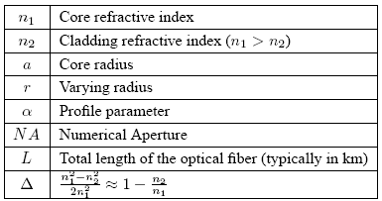
Fiber Key Parameters

Slide 37
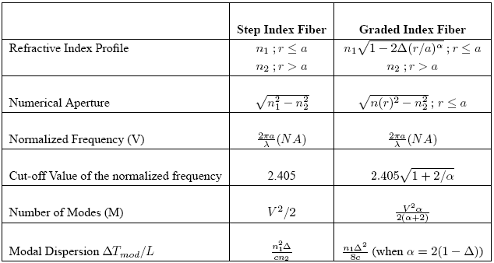
Fiber Key Parameters

Slide 38
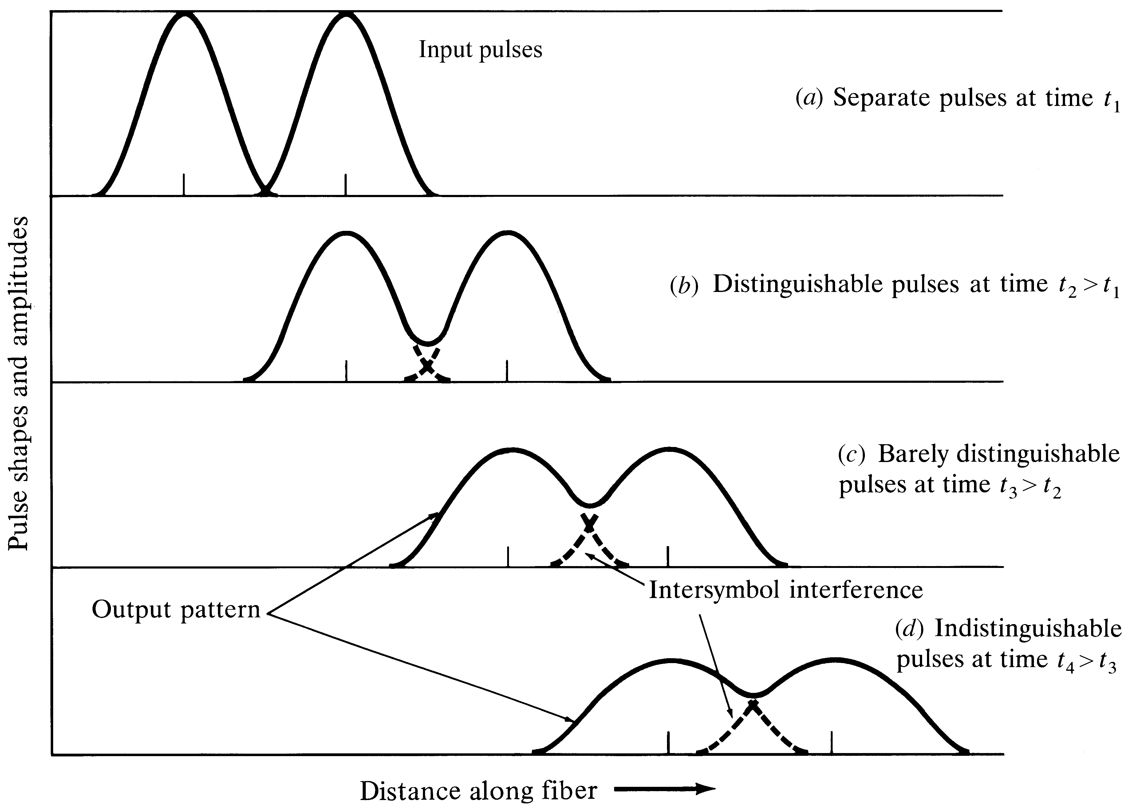
Effects of Dispersion and Attenuation
Notes:
7

Slide 39
Dispersion for Digital Signals

Slide 40
Modal Dispersion

Slide 41

Major Dispersions in Fiber
Modal Dispersion: Different modes travel at different velocities, exist only in multimode fibers
This was the major problem in first generation systems
Modal dispersion was alleviated with single mode fiber
Still the problem was not fully solved

Slide 42
Dispersion in SMF
Material Dispersion: Since n is a function of wavelength, different wavelengths travel at slightly different velocities. This exists in both multimode and single mode fibers.
Waveguide Dispersion: Signal in the cladding travels with a different velocity than the signal in the core. This phenomenon is significant in single mode conditions.
Group Velocity (Chromatic) Dispersion
= Material Disp. + Waveguide Disp.

Slide 43
Group Velocity Dispersion

Slide 44
Modifying Chromatic Dispersion
GVD = Material Disp. + Waveguide dispersion
Material dispersion depends on the material properties and difficult to alter
Waveguide dispersion depends on fiber dimensions and refractive index profile. These can be altered to get:
1300 nm optimized fiber
Dispersion Shifted Fiber (DSF)
Dispersion Flattened Fiber (DFF)

Slide 45
Material and Waveguide Dispersions

Slide 47
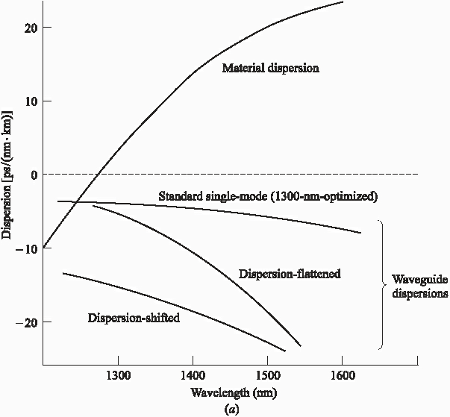
Different WG Dispersion Profiles
WGD is changed by
adjusting fiber profile

Slide 48
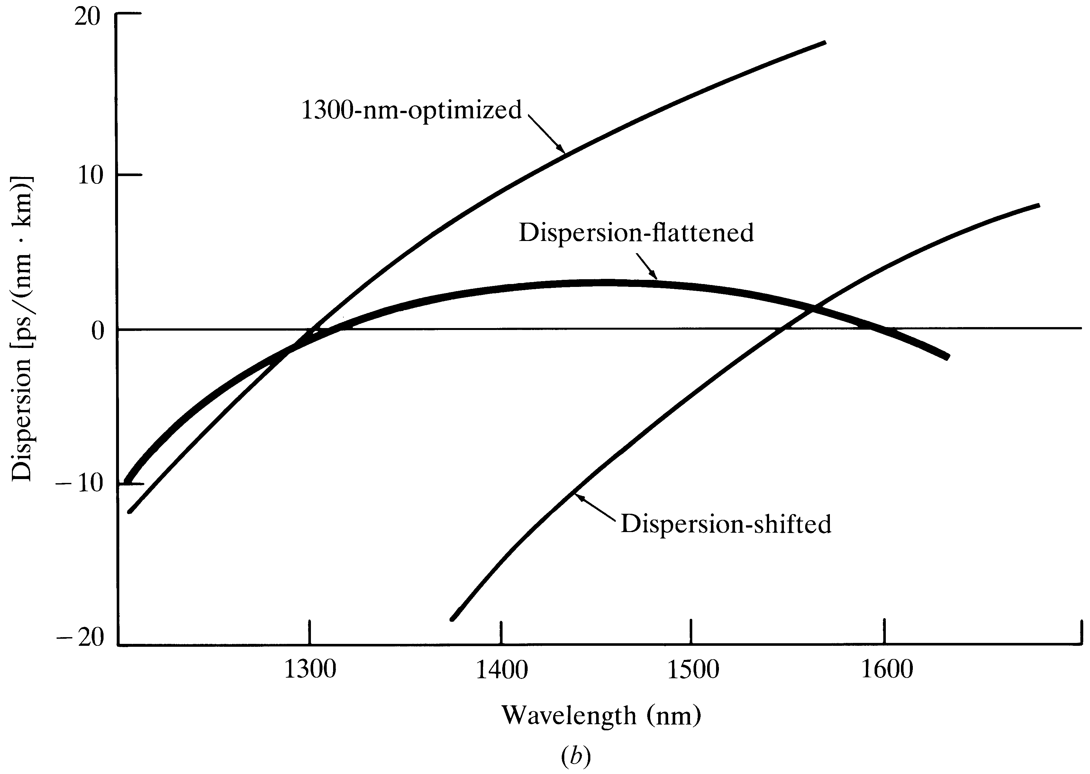
Dispersion Shifting/Flattening
(Standard)
(Low Dispersion throughout)
(Zero Disp. At 1550 nm)

Slide 50
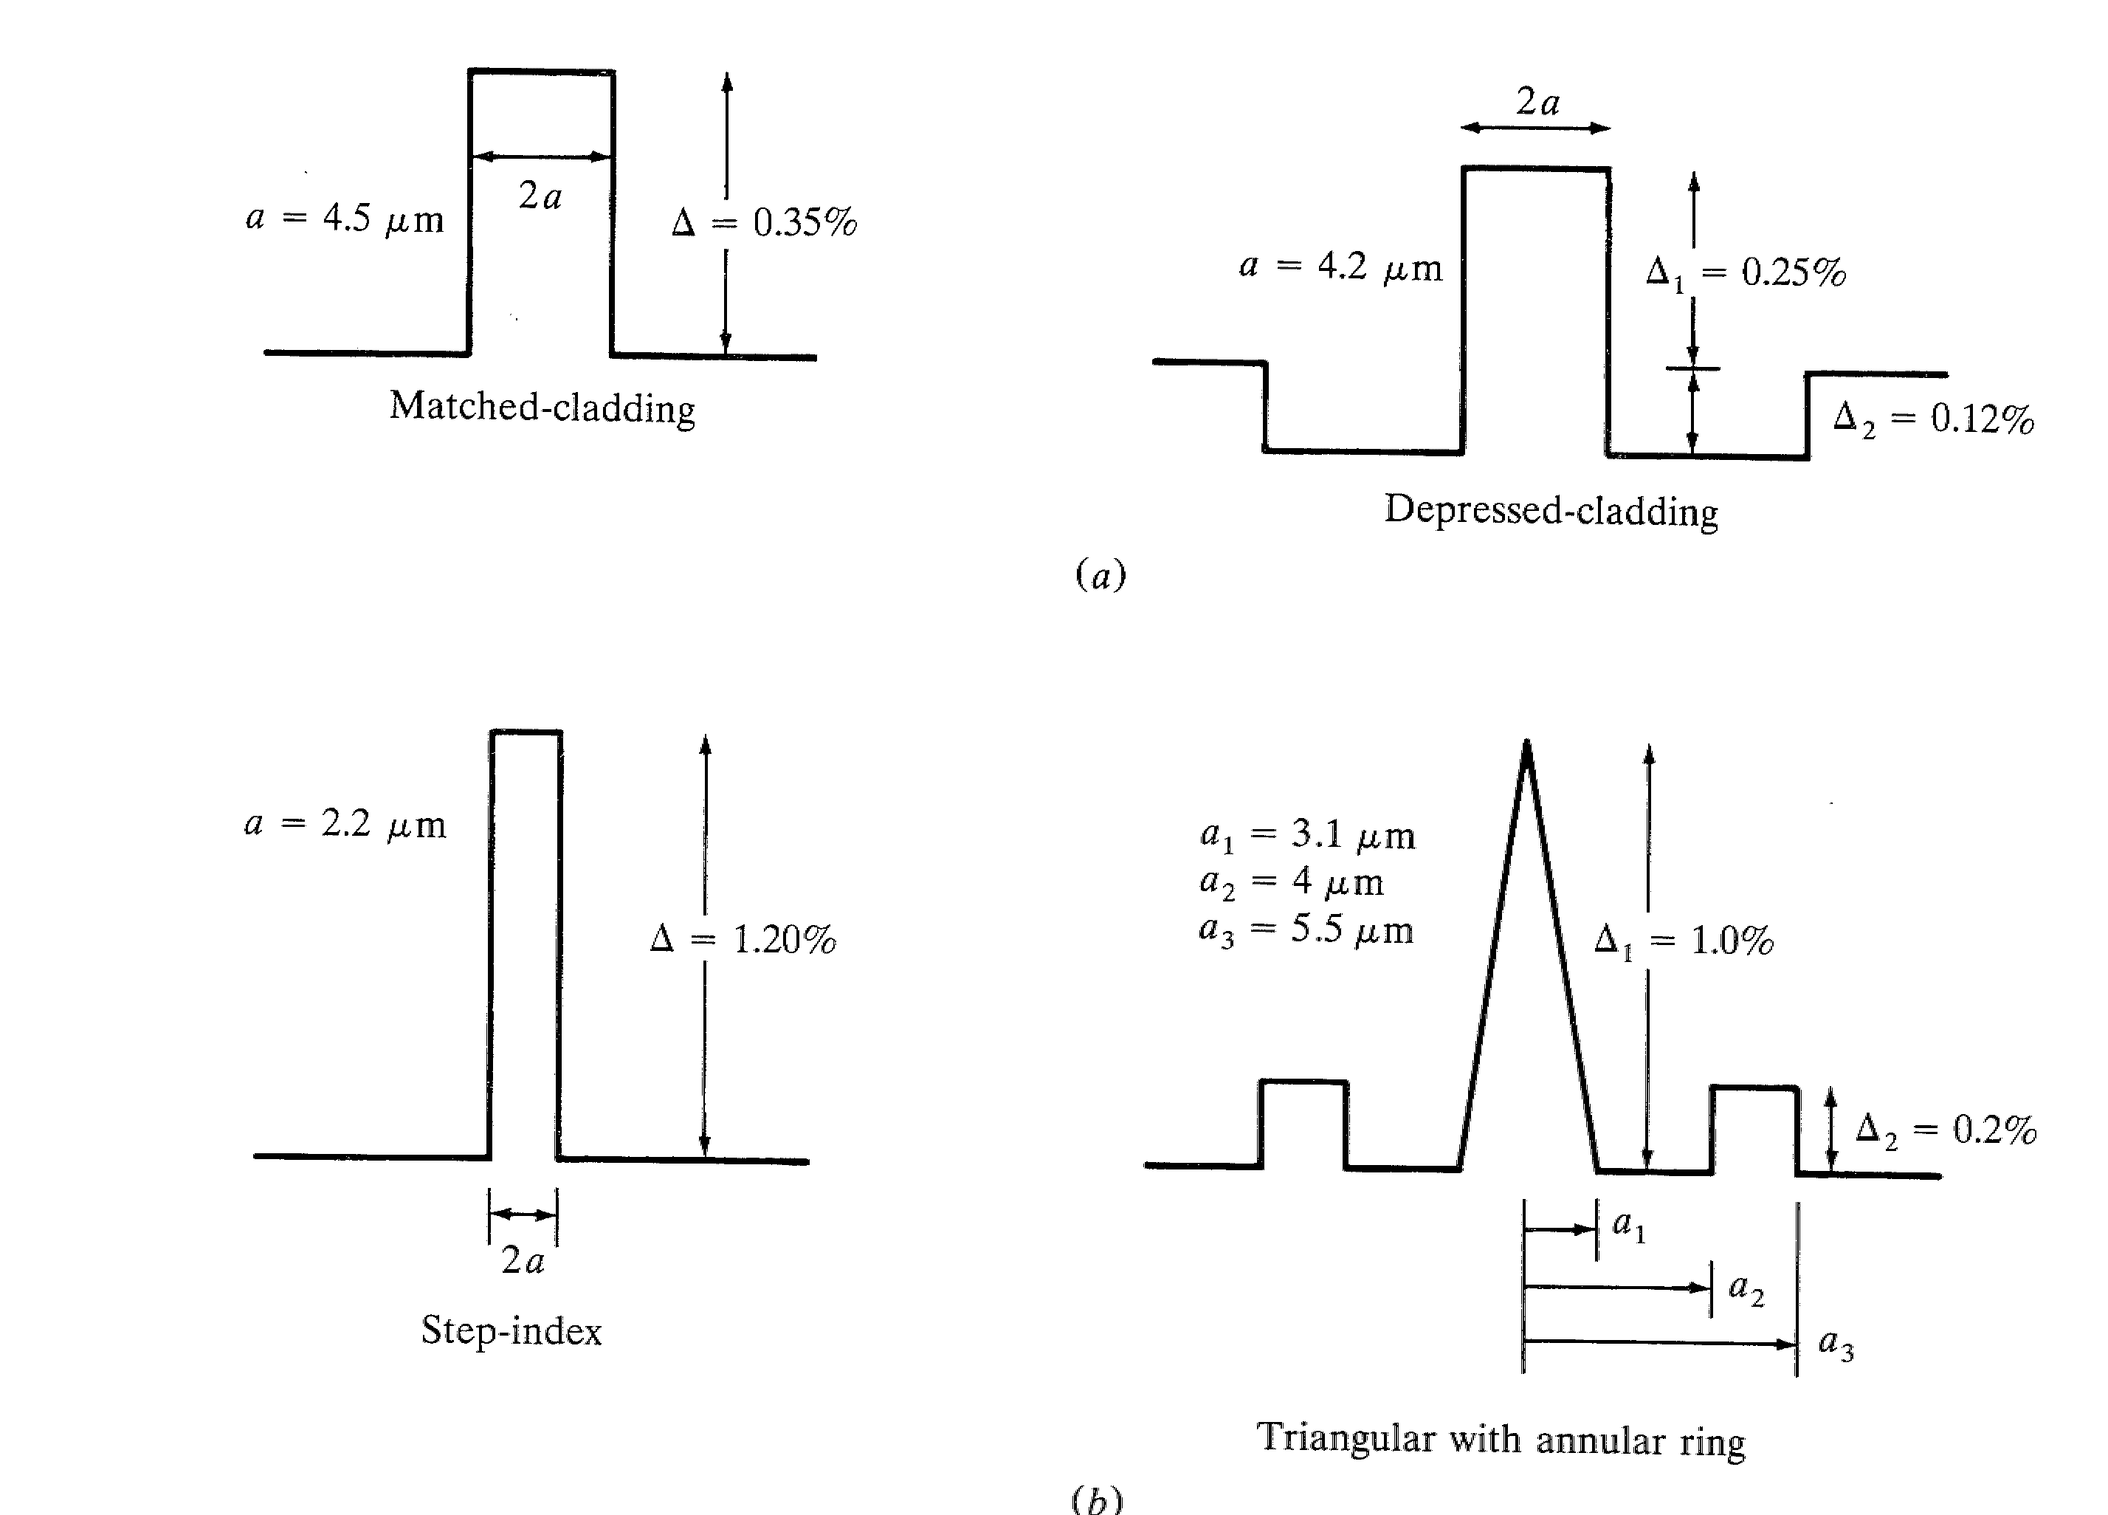
Specialty Fibers with Different Index Profiles
1300 nm optimized
Dispersion Shifted

Slide 51
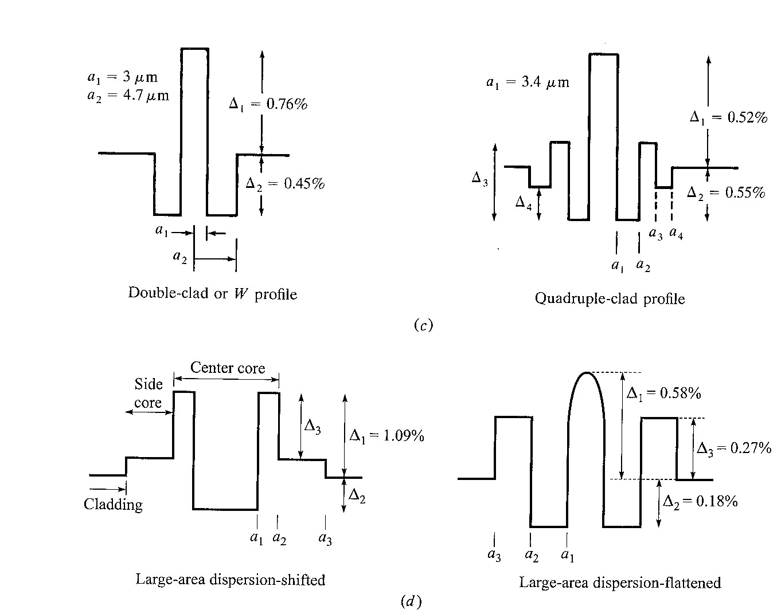
Specialty Fibers with Different Index Profiles
Dispersion
Flattened
Large area dispersion shifted
Large area dispersion flattened

Slide 52
Polarization Mode Dispersion
Since optical fiber has a single axis of anisotropy, differently polarized light travels at slightly different velocity
This results in Polarization Mode Dispersion
PMD is usually small, compared to GVD or Modal dispersion
May become significant if all other dispersion mechanisms are small

Slide 53
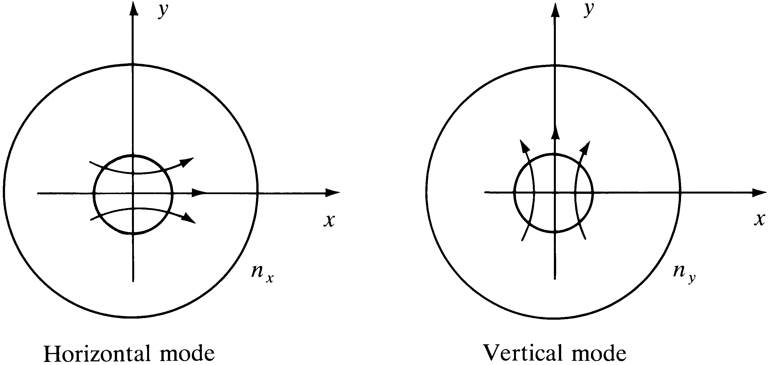
X and Y Polarizations
A Linear Polarized wave will always have two orthogonal components.
These can be called x and y polarization components
Each component can be individually handled if polarization sensitive components are used

Slide 54
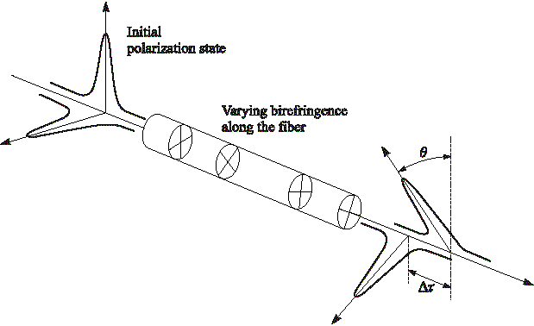
Polarization Mode Dispersion (PMD)
Each polarization state has a different velocity → PMD
Notes:
8

Slide 55
Birefringence
Birefringence is the decomposition of a ray of light into two rays types of (anisotropic) material
In optical fibers, birefringence can be understood by assigning two different refractive indices n_{x} and n_{y} to the material for different polarizations.
In optical fiber, birefringence happens due to the asymmetry in the fiber core and due to external stresses
There are Hi-Bi, Low-Bi and polarization maintaining fibers.

Slide 56




Total Dispersion
For Multi Mode Fibers:
(Note for MMF ΔT_{GVD} ~= ΔT_{mat}
For Single Mode Fibers:
But Group Velocity Disp.
Hence,
(ΔT_{pol} is usually negligible )

Slide 57
Permissible Bit Rate
As a rule of thumb the permissible total dispersion can be up to 70% of the bit period. Therefore,

Slide 58
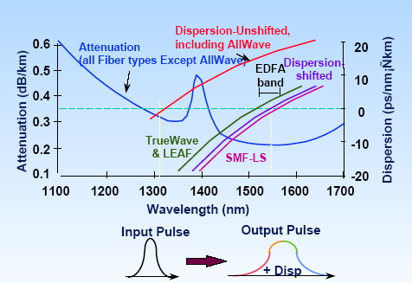
Disp. & Attenuation Summary

Slide 59
Fiber Optic Link is a Low Pass Filter for Analog Signals

Slide 60
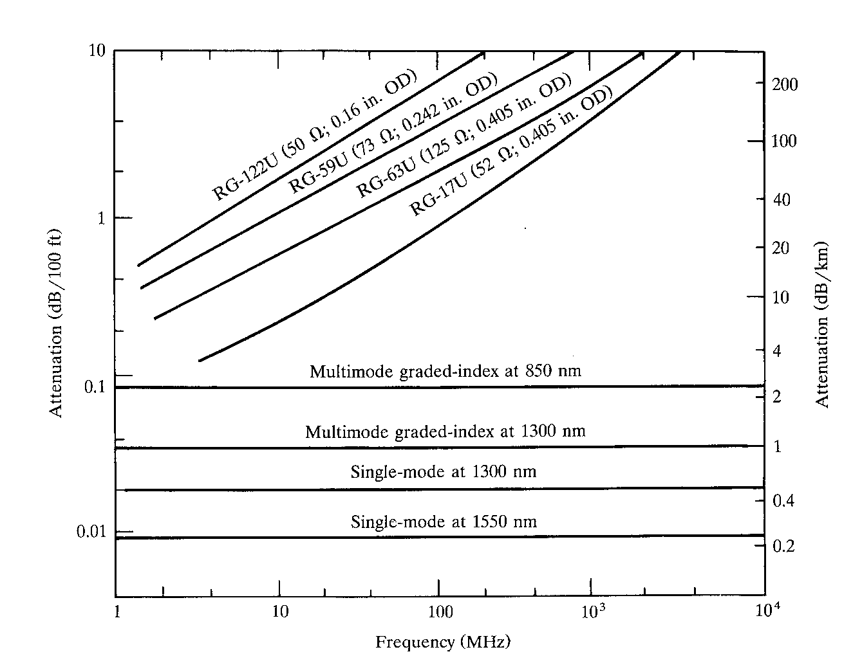
Attenuation Vs Frequency
Fiber attenuation does not depend on modulation frequency

Slide 61
Attenuation in Fiber
Attenuation Coefficient
Silica has lowest attenuation at 1550 nm
Water molecules resonate and give high attenuation around 1400 nm in standard fibers
Attenuation happens because:
Absorption (extrinsic and intrinsic)
Scattering losses (Rayleigh, Raman and Brillouin…)
Bending losses (macro and micro bending)

Slide 62
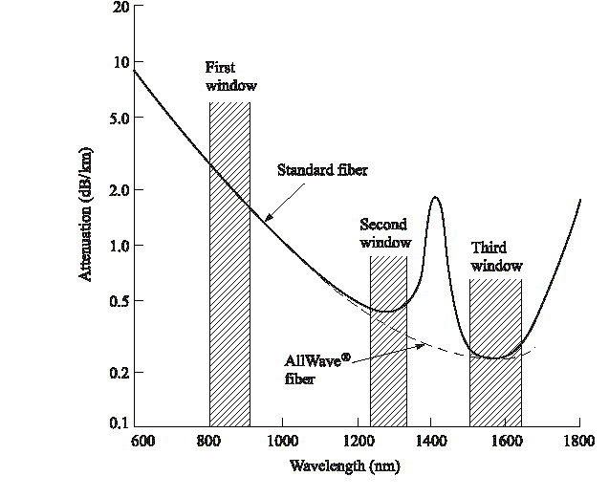
All Wave Fiber for DWDM
Lowest attenuation occurs at
1550 nm for Silica
Notes:
1

Slide 63
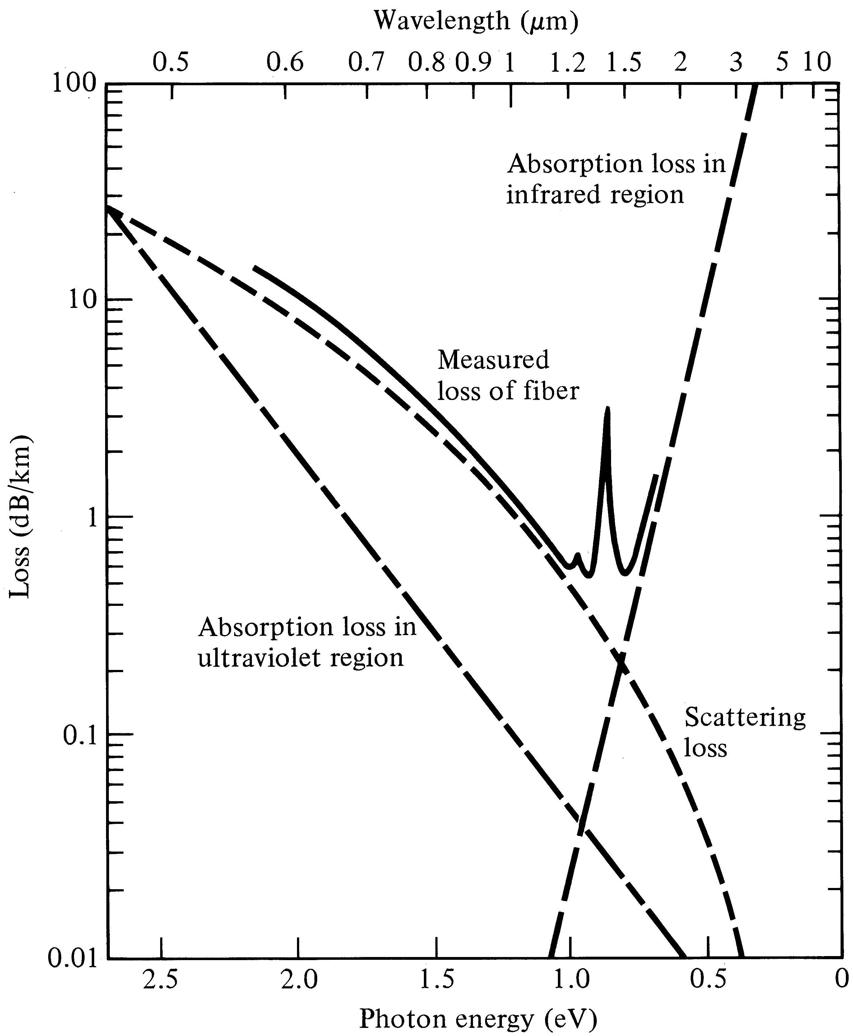
Attenuation characteristics
Notes:
3

Slide 64
Bending Loss
Note:
Higher MFD → Higher Bending Loss

Slide 65
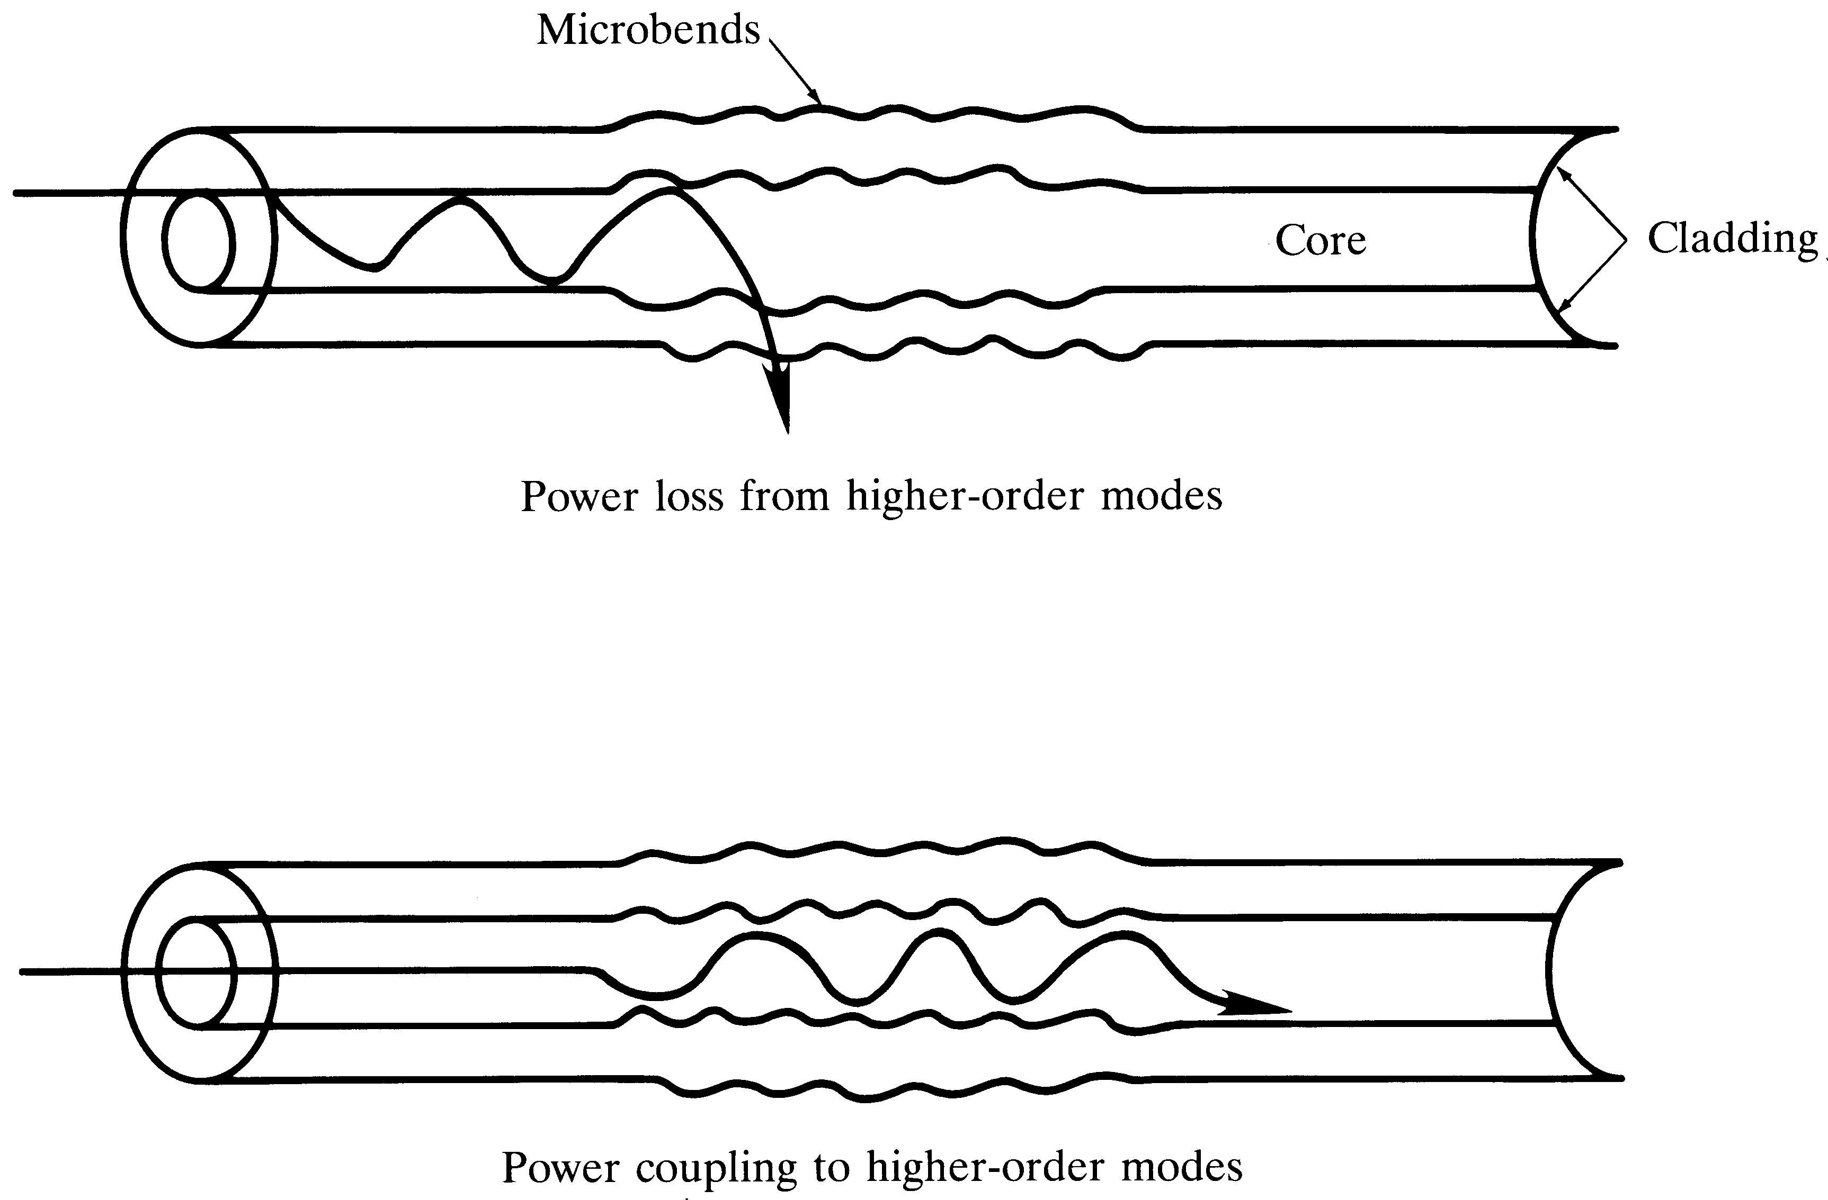
Micro-bending losses
Notes:
6

Slide 66
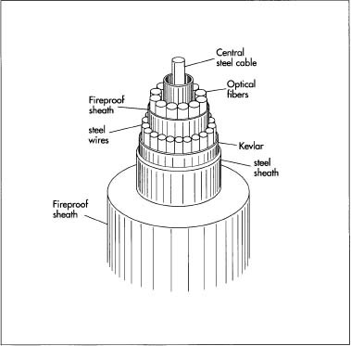
Fiber Production
The Fiber Cable

